Slide 1


Sales Analysis Dashboard
Gahyethri Ponnaboina

Slide 2
Topics:-
Introduction
Key Findings
Actionable
Methodologies
Approches
Insights

Slide 3

Introduction
The Sales Analysis Dashboard provides a comprehensive view of business performance by analyzing key sales metrics, customer insights, product trends, and regional performance. It offers real-time data visualization, enabling businesses to track total sales, profits, and order trends over time.
The dashboard highlights top-performing products, identifies high-value customers, evaluates shipping efficiency, and assesses the impact of discounts on profitability.
With interactive charts and detailed insights, this tool helps organizations make data-driven decisions to optimize sales strategies, improve operational efficiency, and maximize revenue growth.

Slide 4

Key Findings
Identifying Unique Values in Categorical Columns.
Designed Column Charts Using Top N Filters to Showcase the Top 10 Values
Tabular Representation of Min and Max Values for Each Numerical Column
Analyzing the Distribution of Each Numerical Column with Histograms
Visual cards highlight average values for each column.

Slide 5

Insights
Certain categories show higher profit margins, providing opportunities for focused marketing strategies.
Certain categories show higher profit margins, providing opportunities for focused marketing strategies.
Discounts influence sales volume, but excessive discounting impacts overall profit margins.
Sales are stronger in certain regions/cities, offering potential areas for regional marketing focus or expansion.
Some products are consistently top performers, while others underperform and may need further marketing efforts

Slide 6

Actionable
Apply a correlation coefficient to quantify the strength of the relationship between sales and profit.“
Segment sales and profit data by region or team to identify high-performing areas.
Look for seasonal patterns in sales and profit to forecast future performance.
Visualize missing data patterns to identify any systematic absence across certain variables.
Use a scatter plot or a matrix to compare different profit and sales bins side-by-side."

Slide 7

Methodologies
Import and clean data.
Create DAX measures for key metrics.
Use cards, charts, and line graphs for visuals.
Add filters and slicers for interactivity.
Enable drill-down for detailed views.
Add filters for time, region, or product to make the dashboard interactive.
Allow users to click for detailed views of specific data points.

Slide 8

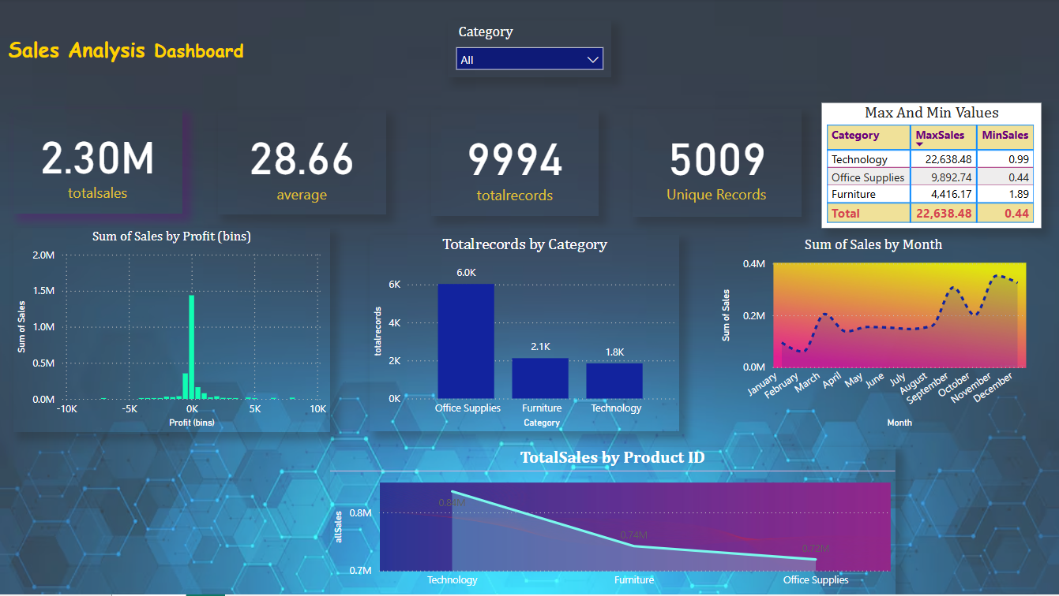
Dashborads

Slide 9
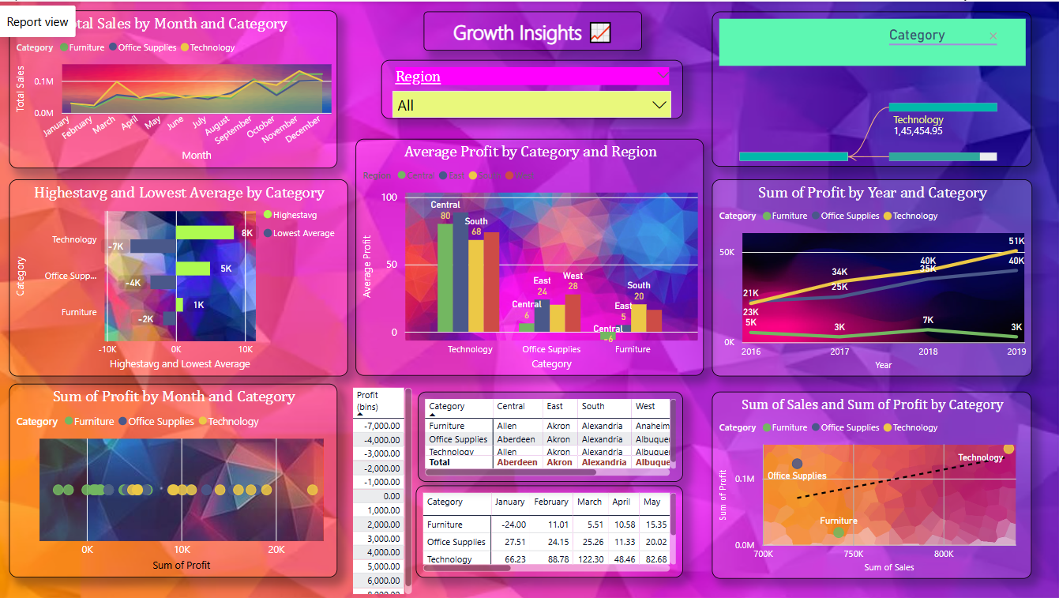

Slide 10
